Slide 1
CS5551 Advanced Software Engineering
MVC with Angular and Node.js and MongoDB

Slide 2
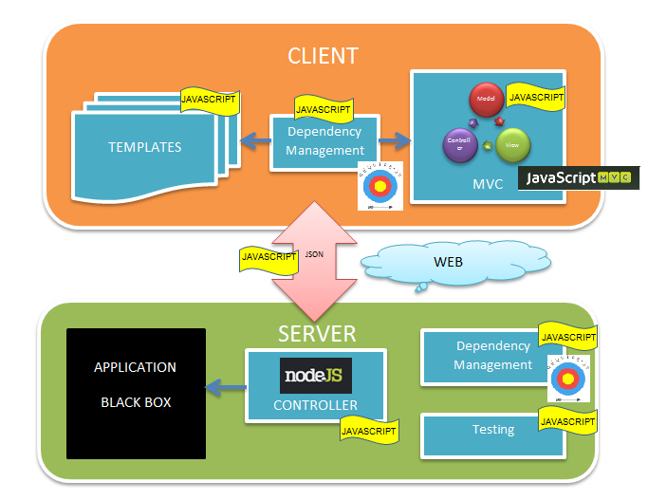
NextGen Enterprise Applications
‘JavaScript Everywhere’
With SSJS platforms - JavaScript runtime used for easily building fast, scalable network based applications.
an event-driven, non-blocking I/O model that makes the server lightweight and efficient,
perfect for data-intensive real-time applications that run across distributed devices.
many enterprises like LinkedIn, Ebay, Yahoo.
http://nsinfra.blogspot.com/2012/08/javascript-everywhere.html

Slide 3
NextGen Enterprise Applications
Javascript becomes a mainstream language used for both front- and back-end.
With adaption of best practices and patterns in client side frameworks, Javascript dependencies can be easily managed and optimally loaded in the browser more efficiently and quickly.
Data interchange format of course is JSON.
NoSQL databases are a game-changer on the back-end.
http://nsinfra.blogspot.com/2012/08/javascript-everywhere.html

Slide 4
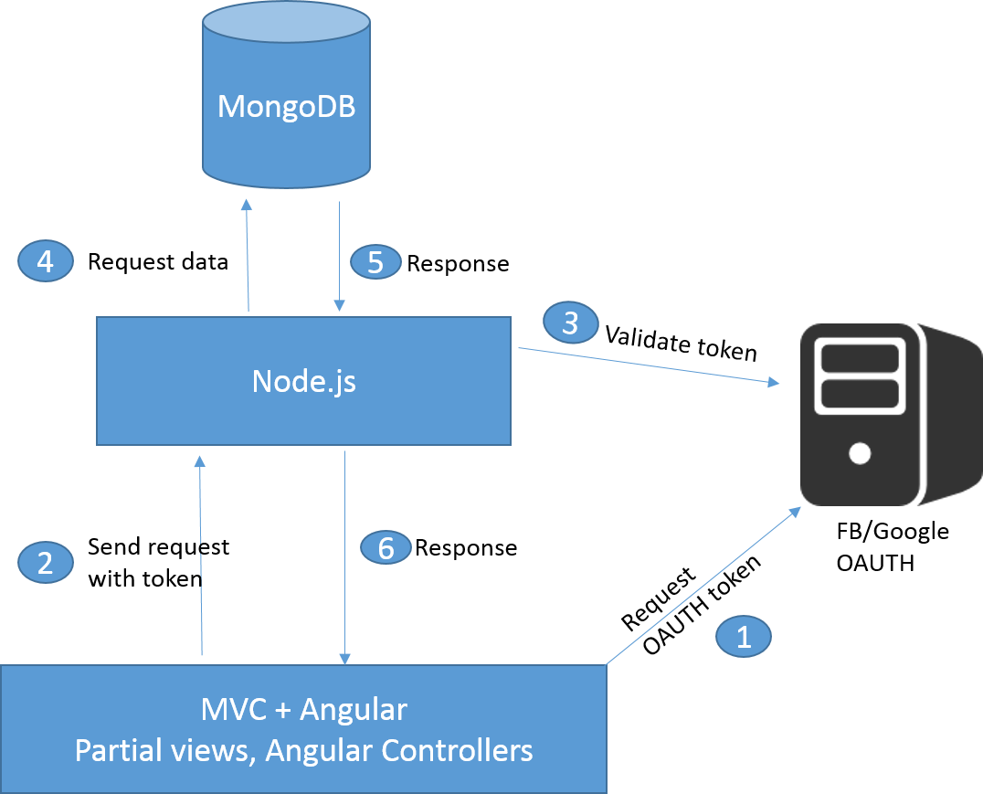
E-commerce Application using MVC with Angular and Node.js

Slide 5
“JavaScript everywhere”
MEAN is a JavaScript and Node.js full-stack framework comprised of four main technologies:
MongoDB (database)
Express (middleware)
AngularJS (front-end)
Node.js (server platform)
https://goranzugic.wordpress.com/category/node-js/

Slide 6
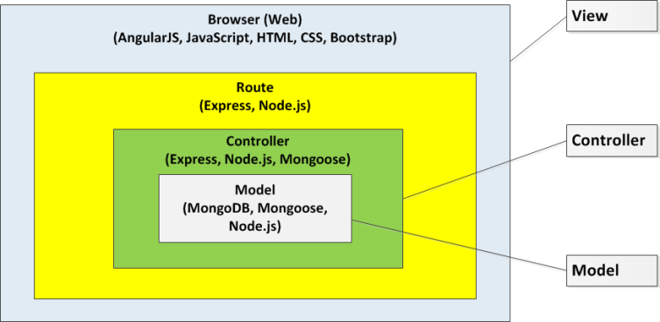
MEAN Architectural Patterns
https://goranzugic.wordpress.com/category/node-js/

Slide 7
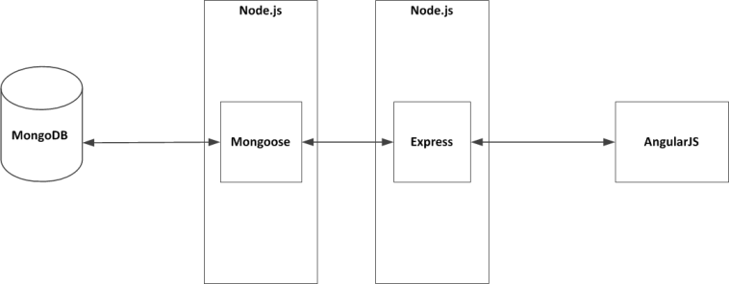
REST API creates a stateless interface to your database
MongoDB communicates with Mongoose only. Mongoose communicates with Node.js and Express and AngularJS communicates with Express only.

Slide 8
MEAN main technologies
MongoDB resolves relationships between documents by either embedding related documents or referencing related documents.
Mongoose is a MongoDB object data modeling (ODM) tool designed to work in an asynchronous environment. Besides the data modeling in Node.js, Mongoose also provides a layer of CRUD features on top of MongoDB. It also makes it easier to manage connections to MongoDB databases and perform data validations.
Express is a middleware framework for Node.js that abstracts away some common web server functionalities including session management, routing, templating, and others.
Node.js is a software platform based on JavaScript to build your own web server and applications that will run on top of it. Node.js applications when codded correctly are fast and they efficiently use system resources.

Slide 9
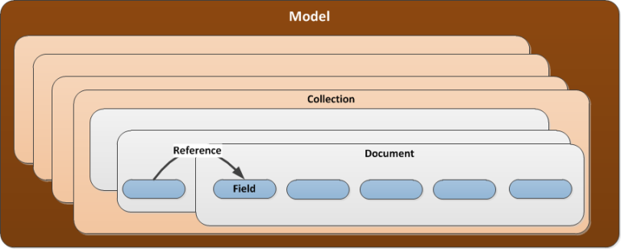
MongoDB
MongoDB is a NoSQL document-based database management system which data model includes:
Collections
Documents
Fields
References

Slide 10
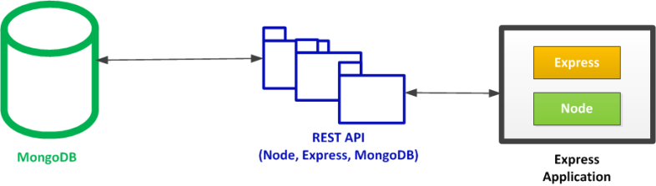
MEAN Framework: Pattern
Node.js and Express Application (NEA)
HTML and content are directly delivered from the server.
The HTML content requires data that is delivered via REST API. REST API is developed with Node.js, Express, Mongoose and MongoDB.
https://goranzugic.wordpress.com/category/node-js/

Slide 11
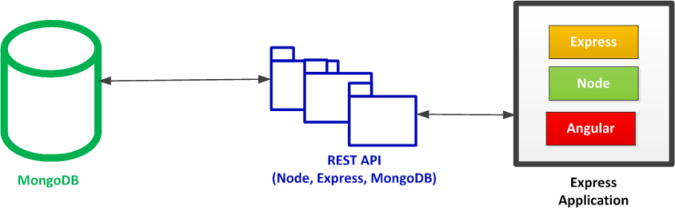
MEAN Framework: Pattern
Node.js and Express Application with AngularJS Addition for Better Interactivity (NEA2)
If you need a richer interactive experience for your users, you can add AngularJS to your pages.
https://goranzugic.wordpress.com/category/node-js/

Slide 12
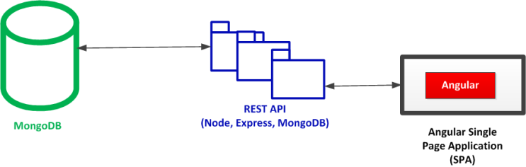
MEAN Framework: Pattern
AngularJS Single Page Application (SPA)
In order to implement Single Page Applications, AngularJS is needed.
https://goranzugic.wordpress.com/category/node-js/

Slide 13
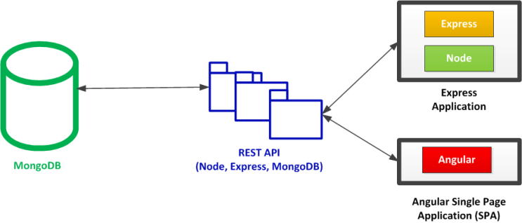
MEAN Framework: Pattern
Hybrid Pattern: NEA and SPA
Combination of application with both NEA and SPA.
NEA best supported : short duration of user interactions, low interactions, content rich, etc.
SPA best supported : feature-rich, highly interactive, long duration of user interactions, private, fast response, etc..
https://goranzugic.wordpress.com/category/node-js/

Slide 14
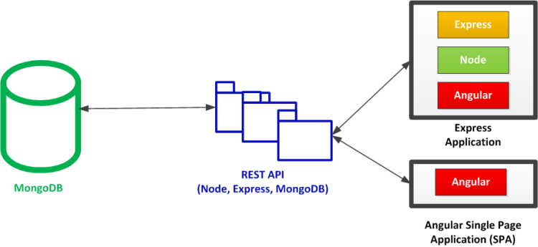
MEAN Framework: Pattern
Hybrid Pattern: NEA2 and SPA
NEA2 and SPA is like NEA and SPA with a bit richer interactivity on the server side (NEA2) via AngularJS addition.
https://goranzugic.wordpress.com/category/node-js/

